Slide 1
Sound analyzer
Mr. Pongkorn Settasompop (New)
Miss. Nutthakan Limpanawannakul (Nut)
Miss. Plubploy Jandaeng (Peem)
Professor.Chao-Min Wu
(Laboratory of biomedical system modeling and speech and hearing research)
pinterest.com

Slide 2
Motivation
The sound analyzer project is about how can we know about sound like “a” sound and how can we analyze sound such as “a” sound what is a solution that can reveal “a” is an “ah” sound in human voice.
pinterest.com

Slide 3
Plan to Do
We plan to use Matlab and C# to do sound analyzer program with 6 functions:
Record sound and save in wave file(wav.)
Convert sound to waveform.
Convert sound to spectrum
Convert sound to spectrogram
Convert sound to pitch
Playback the sound

Slide 4

Work progress
Summary
Functions |  | C# | Matlab
1. | Record sound and save in wave file(wav.) | ✓ | ✓
2. | Convert sound to waveform. | ✓
3. | Convert sound to spectrum | ✓ | ✓
4. | Convert sound to spectrogram | ✓
5. | Convert sound to pitch |  | ✓
6. | Playback the sound | ✓ | ✓

Slide 5
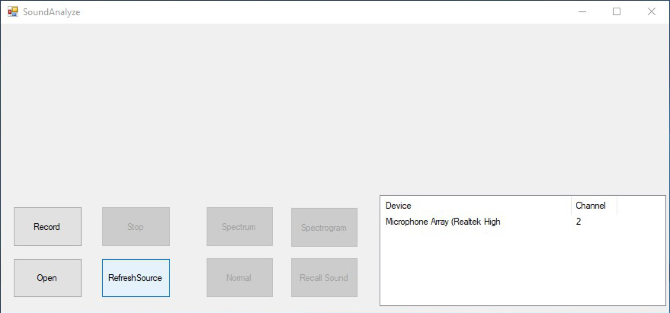

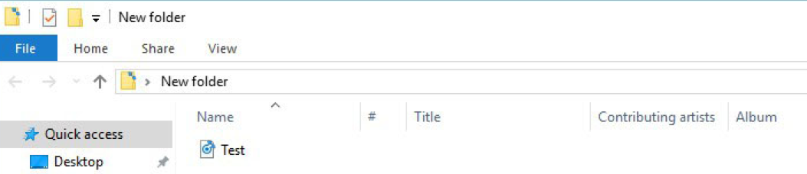
Work Progress : C#
Function 1 : Record sound and save in wave file(wav.)
Before you push the Record button to start recording, you should push the Refresh Source button,
It’s recording now if you want to stop record, push the Stop button.
Then the record will be saved in wave file(.wav).
Refresh Source
Start
Stop

Slide 6
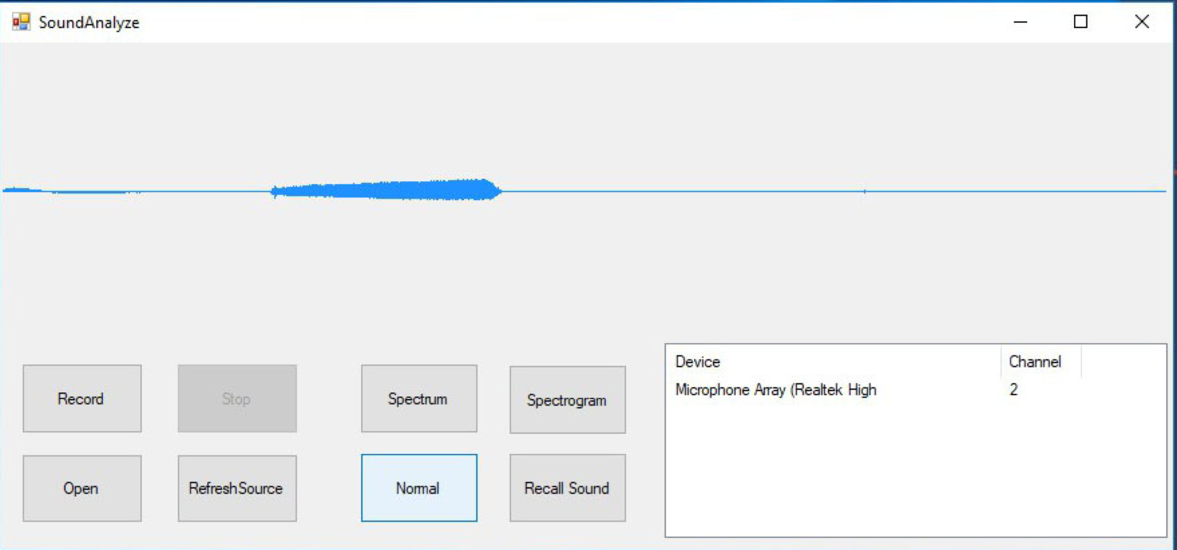
Work Progress : C#
Function 2 : Convert sound to waveform
Push the Open button to open the wave file.
The program will show a simply waveform.

Slide 7
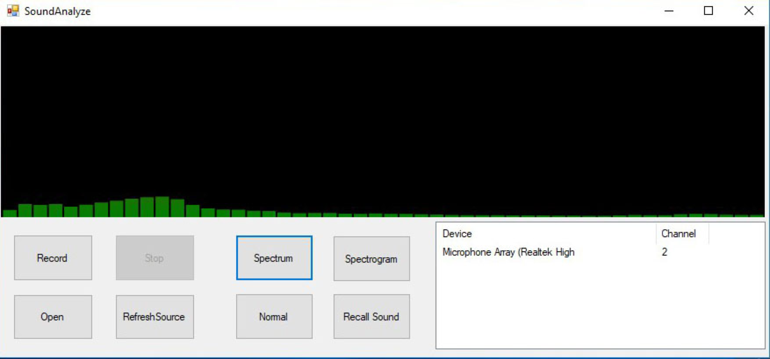
Work Progress : C#
Function 3 : Convert sound to spectrum
After opening the wave file, Push the Spectrum button.
And it will show the spectrum of the wave file.

Slide 8
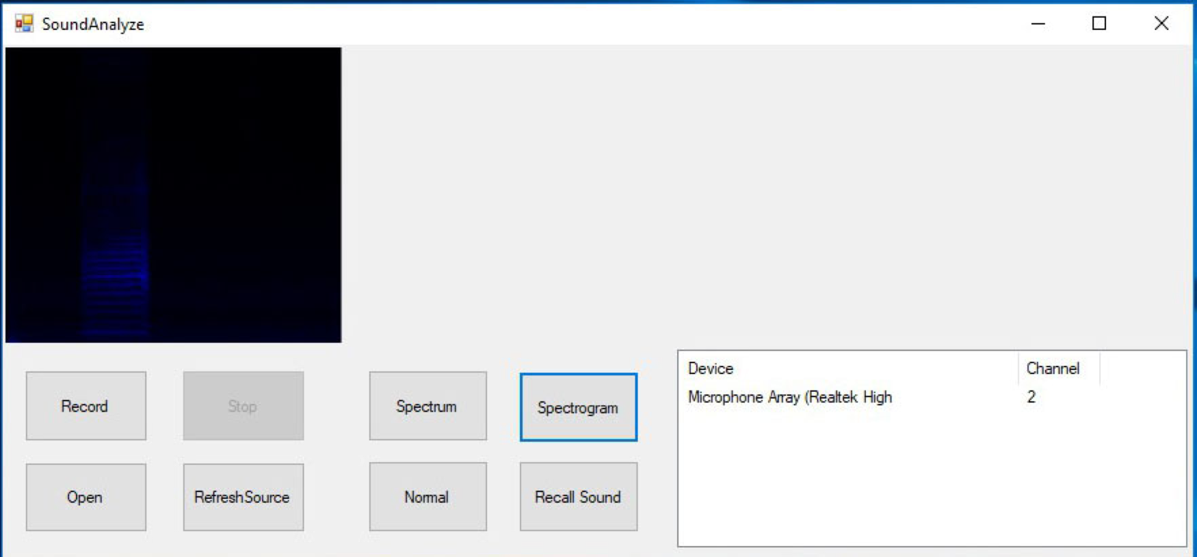

Work Progress : C#
Function 4 : Convert sound to spectrogram
To show the spectrogram of wave file, Push the Spectrum button.

Slide 9
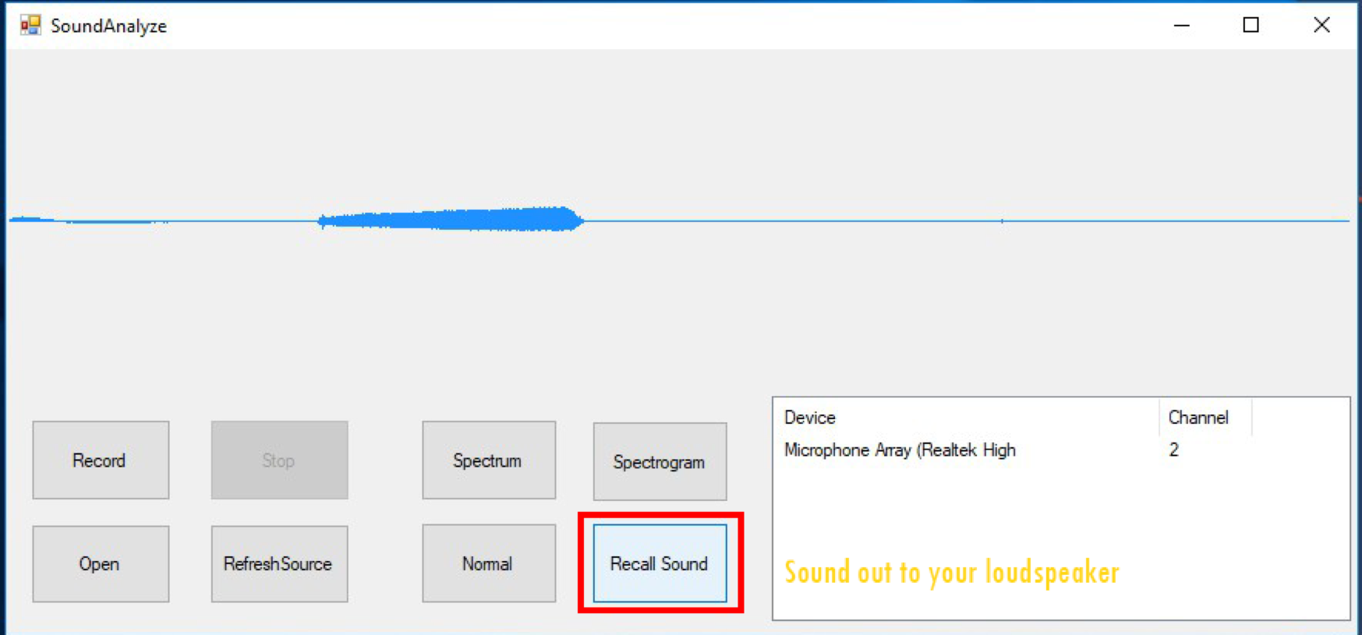
Work Progress : C#
Function 6 : Playback the sound
Click Recall Sound button to playback the wave file

Slide 10

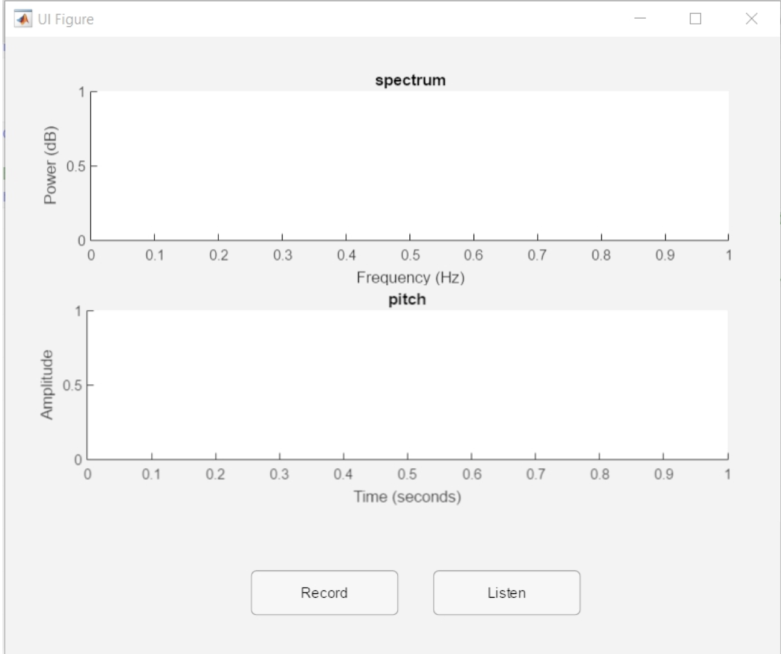

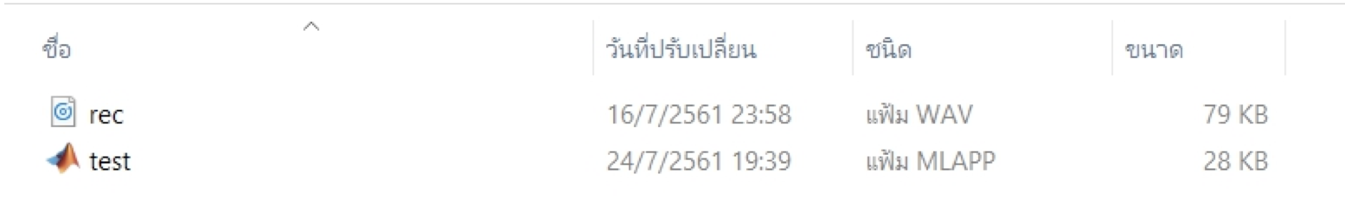
Work Progress : Matlab
Function 1 : Record sound and save in wave file(wav.)
After push the Record button, the program will record the sound in 5 seconds.
And it save the sound in wave file(.wav).

Slide 11
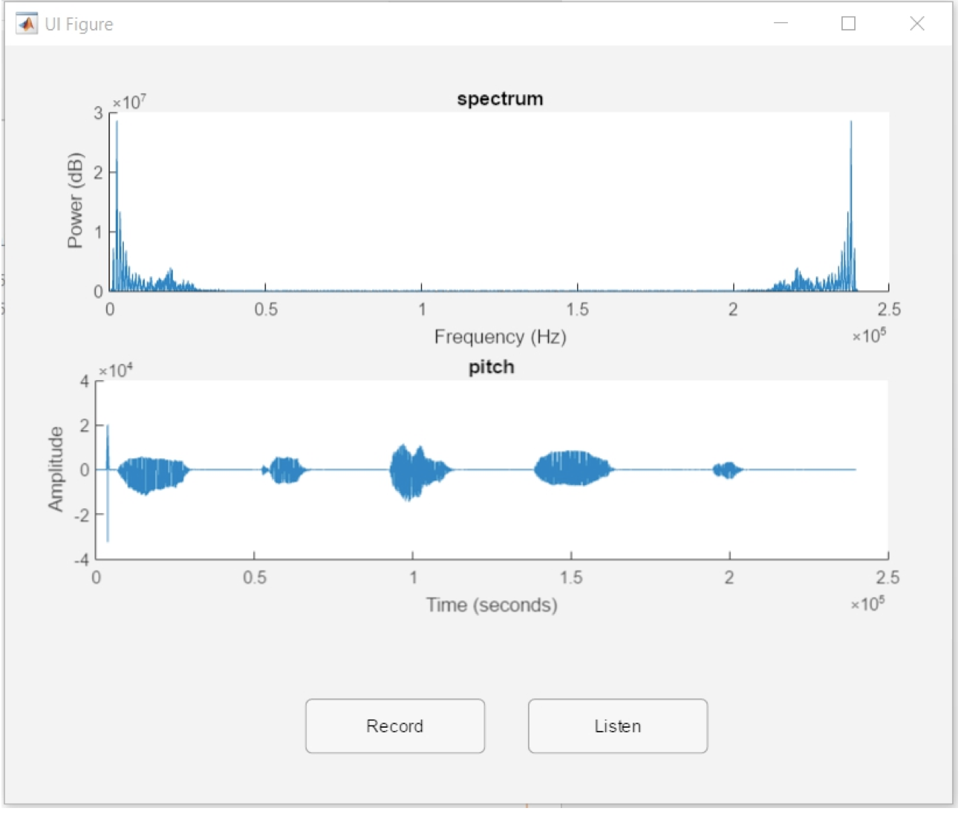
Work Progress : Matlab
Function 3 : Convert sound to spectrum
Function 5 : Convert sound to pitch
When the recording have finished, the program will show spectrum and pitch of the wave file.

Slide 12
Work Progress : Matlab
Function 6 : Playback the sound
Click Listen button to playback the wave file

Slide 13
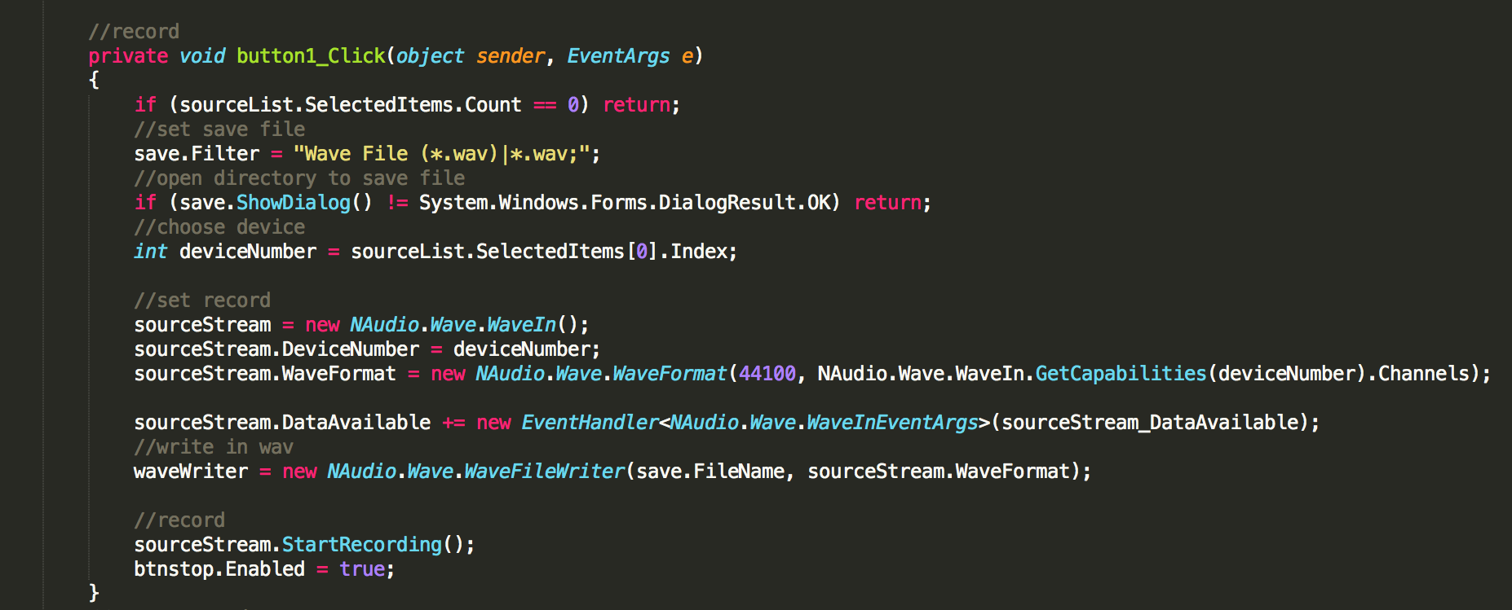
How to record & save sound : c#

Slide 14
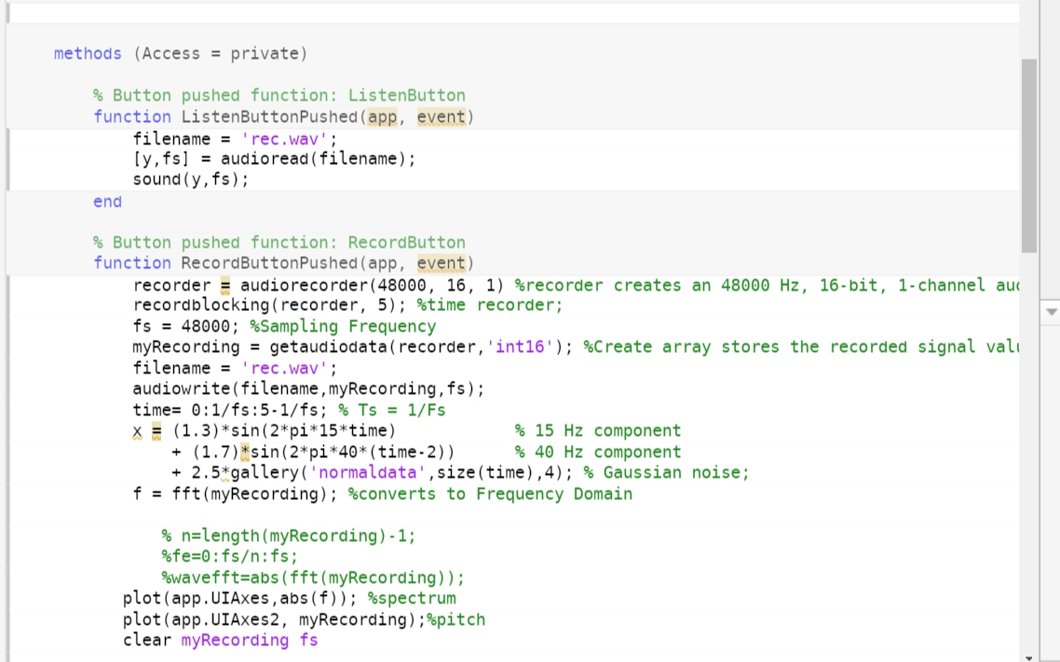
How to record & save sound : matlab

Slide 15

waveform
Waveform is a graph that represent the difference of energy over a time with 2 dimension, one axis is “Time” and the other is “Amplitude”.
Amplitude
time
Waveform from Sound Analyzer program in C#

Slide 16
How to get waveform : C#
Create the waveform by using naudio framework.

Slide 17
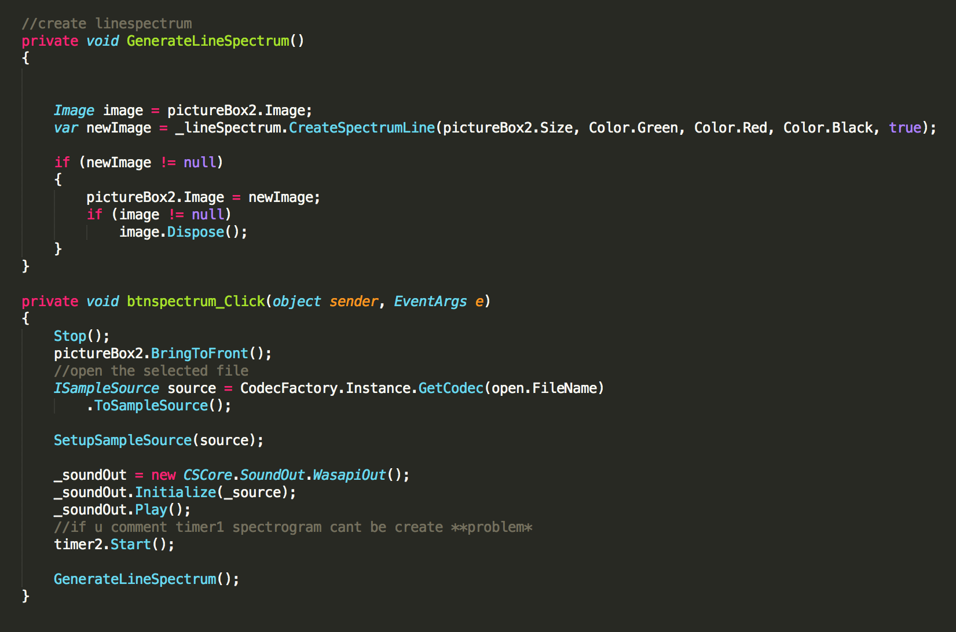
How to get spectrum : c#
Create the spectrum by using cscore framework.
Spectrum from Sound Analyzer program in C#

Slide 18

How to get spectrum : Matlab
Converts the signal data to int16 data type by storing audio signal in int16 array by using function getaudiodata() in Matlab
Use int16 array and a fast Fourier transform (FFT) algorithm to compute the discrete Fourier transform (DFT) of the array
Use the value from the computation to create the spectrum graph
Spectrum from Sound Analyzer program in Matlab

Slide 19
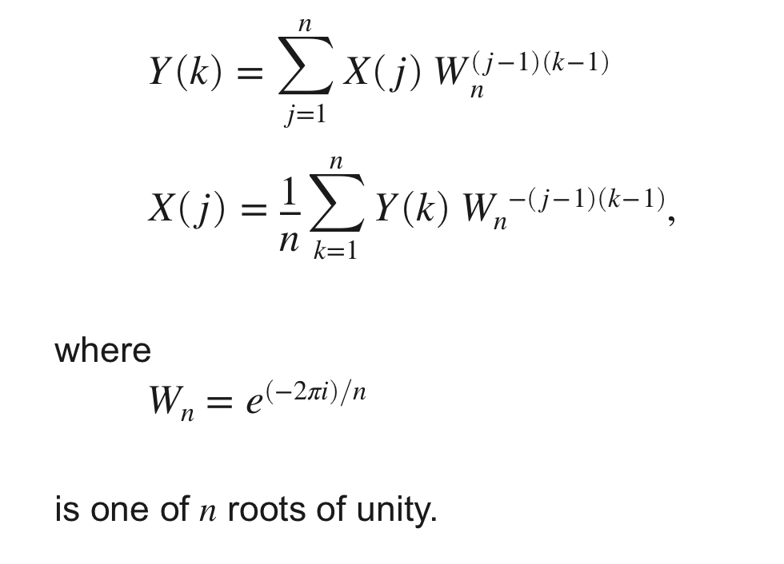
fast Fourier transform (FFT)
Y = fft(X) and X = ifft(Y) implement the Fourier transform and inverse Fourier transform, respectively. For X and Y of length n, these transforms are defined as follows:
https://www.mathworks.com/help/matlab/

Slide 20
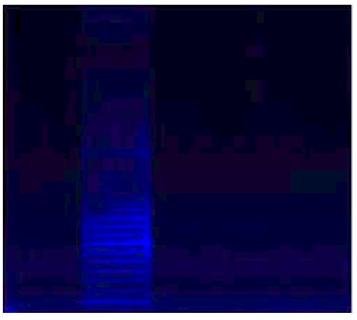
spectrogram
SPECTROGRAM is a visual representation of the spectrum of sound frequencies.
SPECTROGRAM is graph with 2 dimensions, X-axis represents “Time” and Y-axis is “Frequency”. The third dimension represents the amplitude of a particular frequency at a particular time by using the intensity or color of each point in the image.
Spectrogram from Sound Analyzer program in C#
Spectrogram of a male voice saying 'ta ta ta'.
en.wikipedia.org/wiki/Spectrogram

Slide 21
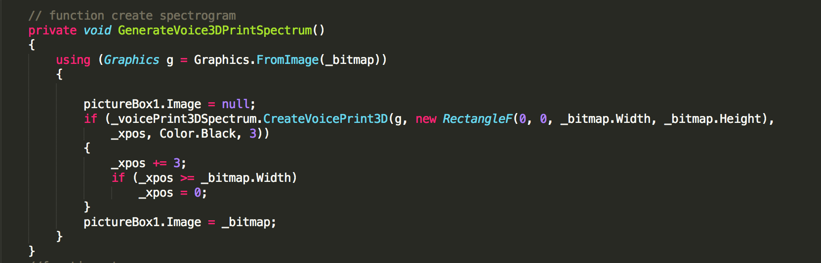
How to get spectrogram : C#
We use cscore framework to create the spectrogram.

Slide 22
How to get Pitch : Matlab
We find the Amplitude by converting the signal data of the record to int16 array by using function getaudiodata()
Then, use the array to create the pitch.
Pitch from Sound Analyzer program in Matlab

Slide 23
Problem
In C#, can’t implement Pitch Function because we can’t implement it on-time and we don’t know how to implement by using external function.
Can’t Fix bug in spectrum and spectrogram because I don’t know about mathematical equation and lack of knowledge about function to implement.
In Matlab, can’t write mathematical equation to plot graph per second.

